Slide 1
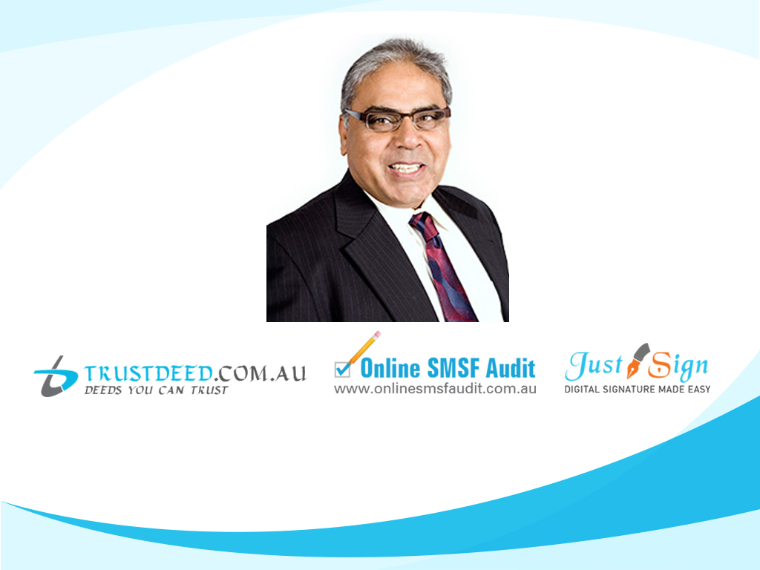
What audit situations require a Contravention report to be lodged?
Manoj Abichandani
SMSF Specialist (UNSW)

Slide 2
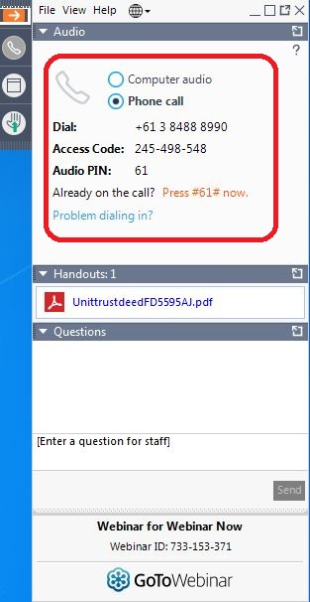
House Keeping - Audio
If Computer sound is not audio able
Phone the number on your panel
Enter Access Code

Slide 3
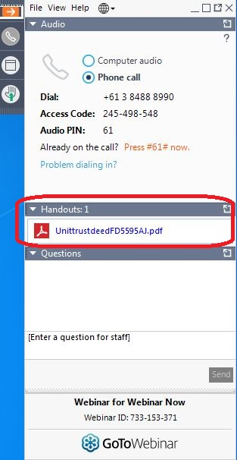
House Keeping – Hand Out
Copy of this Presentation can be downloaded
From the Panel

Slide 4
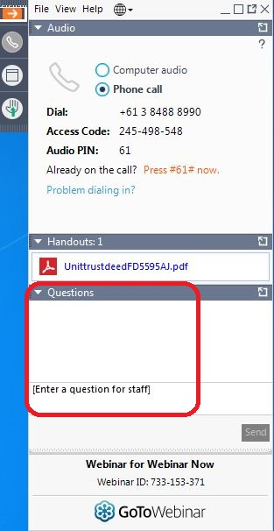
House Keeping – Questions on this Presentation
If you have any Questions on this Presentation
Type in your questions in the panel
Speaker will answer all your questions
after the presentation

Slide 5


Legal & Financial Disclaimer & Disclosure
- Presentation is for educational purposes
In providing the below information, neither Manoj Abichandani (presenter) or an employee of Deed Dot Com Dot Au Pty Ltd is providing any financial or Legal advice as any Financial advice is based on the information provided by you with regard to your financial needs and objectives. The information below is intended to provide only broad, general guidelines which may be helpful in assessing and making decisions about financial products and general information which is available elsewhere that may help meet your financial needs and objectives. This material may also contain general educational topics about investing, legal and financial matters. It is most important that you understand that your actual experience will differ from these illustrations and examples.
That is why you should consult an appropriately qualified financial planner, legal advisor or Estate planner, who can assess your situation with updated data and assumptions on a periodic basis. Information provided here is not intended to be investment advice or a projection of future investment performance. No one can foresee the future and, it is not a projection of the potential return of any investment, nor is it a projection of future inflation rates or the state of the world or domestic economy. You should seek the guidance of a financial or investment professional before proceeding with any investment decision or any super contribution or set up Decision. Our examples and illustration does not contain your income tax calculations and legal concepts; it does not constitute tax or legal Advice. These illustration may require the guidance of a tax, legal or accounting adviser.
In creating the illustration certain assumptions were made with respect to investment returns, the economy, and home loan interest rates . The reports and graphics included are directly dependent on the quality and the accuracy of the data and assumptions (including rates of return and future interest rates) . Where future rates of return are assumed, these returns do not reflect the fees and charges associated with Investments, which would reduce the results. You are encouraged to review and consider performance information, which you can request from your investment professional and other securities advisor who may recommended asset/s that may be referenced in this material when assuming any future rates of return for any super contributions & investment.
Keep in mind that past performance is not a guarantee of future results. A prospectus or PDS must be read carefully when considering any investment in securities or super contribution in a fund.
No liability is assumed resulting from the use of the information contained in this financial presentation and the examples used Responsibilities for financial decisions are exclusively in hand of the viewer and not in hands of the presenter.
Notes:
May require more than one slide

Slide 6
Agenda
What does "Complying Superannuation fund mean"?
What is the meaning of contravention in a SMSF and what is the penalty?
What are the requirements of Audit of a SMSF?
What audit situations require a contravention report to be lodged

Slide 7
What is a Complying Superannuation Fund
SUPERANNUATION INDUSTRY (SUPERVISION) ACT 1993 - SECT 42 & 42A
Complying superannuation fund
An entity is a complying superannuation fund in relation to a year of income for the purposes of this Division if:
Resident superannuation fund
b) either of the following conditions is satisfied:
- no trustee of the entity contravened any of the regulatory provisions in relation to the entity in respect of the year of income
c) Election to be complying within 60 days

Slide 8
What is a Complying Superannuation Fund
Section 45 SIS Act
Complying superannuation fund
(1) A fund is a complying superannuation fund for the purposes of the Income Tax Assessment Act in relation to a year of income (the current year of income ) if, and only if:
- Regulator gives notice to the Trustee - as per Section 40
Comply …. to obtain tax concessions
a) Lower Tax Rate b) ECPI

Slide 9
What is a Contravention
Section 39
Meaning of contravention
(1) For the purposes of this Division, a contravention of a regulatory provision is to be ignored unless the contravention is:
(a) an offence; or
(b) a contravention of a civil penalty provision (Section 193); or
(c) a contravention of a provision mentioned in paragraph 38A(ab).
(1A) In relation to a regulatory provision that states that a person commits an offence if they engage, or fail to engage, in specified conduct, a person is, for the purposes of this Division, taken to contravene the provision if the person engages, or fails to engage, in that conduct.

Slide 10
Civil Penalty Provisions
Section 193
Each of the following provisions of this Act is a civil penalty provision:
(a) subsection 62(1);
(b) subsection 65(1);
(c) subsection 67(1);
(ca) subsection 68B(1);
(d) subsection 84(1);
(e) subsection 85(1);
(f) subsection 95(1);
(g) subsection 97(1);
(h) section 98;
(i) subsection 106(1);
(j) subsection 109(1);
(ja) subsection 109(1A);
(k) subsection 117(3);
(l) subsection 242M(1);
(m) section 388;
(n) section 394.

Slide 11
What is a Provision of the Act
Section 38A (ab)
(ab) for a superannuation entity that is a self managed superannuation fund--any of the following provisions in Schedule 1 to the Taxation Administration Act 1953 :
(i) subsections 284-75(1) and (4) and section 284-95;
(ii) Division 390;
(iii) subsection 136-80(1); or
(b) any of the following provisions of the Corporations Act 2001 as applying in relation to financial products (within the meaning of Chapter 7 of that Act) that are interests in the superannuation entity:

Slide 12
Requirement of Audit
Section 35C
Audit of accounts and statements
For each year of income, each trustee of a superannuation entity that is a self managed superannuation fund must ensure that an approved SMSF auditor is appointed to give the trustee or trustees a report, in the approved form, of the operations of the entity for that year.

Slide 13
What must the Audit Report Contain ?
Section 35C (5)
(b) must include a statement by the auditor as to the extent of the auditor's compliance with the auditor independence requirements referred to in paragraph 128F(d); and
(c) must include a statement by the auditor as to whether, in the auditor's opinion, each trustee of the entity has, during the year of income, complied with the provisions of this Act and the regulations that are identified in the form.

Slide 14
What is a Contravention
Either an:
Action prohibited (Engages) under the SISA and SISR
  Lending to a related party (Sec. 65)
  SMSF borrows (Sec. 67)
Inaction (Fails to Engage) that results in the trustee not meeting their obligations under the SISA and SISR.
  Not withdrawing the minimum pension amount (Sec 1.06)
  Not adding member as Director of Corporate trustee of the SMSF (Sec 17A)

Slide 15
Trustees Duty to notify the Regulator of significant adverse events
Section 106
If a trustee of a superannuation entity becomes aware of the occurrence of an event having a significant adverse effect on the financial position of the entity, the trustee must ensure that a trustee of the entity immediately notifies the Regulator in writing of the event.
Section 166 imposes an administrative penalty for a contravention in relation to a SMSF

Slide 16
Obligations of auditors--compliance
Section 129
(a) the person forms the opinion that it is likely that a contravention of any of the following may have occurred, may be occurring, or may occur, in relation to the entity:
Trustee and Regulator to be told about the matter
Section 130
(a) the person forms the opinion that the financial position of the entity may be, or may be about to become, unsatisfactory; and
Regulator and trustee to be told about the financial position

Slide 17
Auditor can be liable for damages to Trustees
Section 218 of SIS Act
Recovery of profits, and compensation for loss, resulting from contravention
(1) If a civil penalty provision in relation to a superannuation entity is contravened by a person other than a trustee of the entity, a trustee of the entity may, by proceedings in a court of competent jurisdiction, recover from the person, as a debt due to the trustee:
(a) if that or another person has made a profit because of the act or omission constituting the contravention--an amount equal to the amount of that profit; and
b) if the entity has suffered loss or damage as a result of that act or omission--an amount equal to the amount of that loss or damage;

Slide 18
What needs to be Reported
Financial position of the fund may be, or may be about to become, unsatisfactory
Contravention of the Superannuation Industry (Supervision) Act 1993 (SISA) or SISR specified in the contravention report may have occurred, may be occurring or may occur, and the contravention meets the prescribed reporting criteria (Section 38A (ab) etc)
Anything else you consider will assist ATO in performing their duties under the SISA and the SISR

Slide 19
Types of contraventions reported to the ATO (up to 30 June 2020)
Contravention types | Number (%) | Value (%)
Loan to member/financial assistance (Sec. 65) | 20.9% | 14.4%
In-house assets (Sec. 71) | 18.3% | 27.2%
Administrative-type contraventions (Various) | 12.0% | 1.8%
Separation of assets (Section 52 (2) (g) | 12.9% | 26.2%
Operating standard-type contraventions (Various) | 8.3% | 6.5%
Borrowings (Sec. 67) | 8.0% | 7.8%
Sole purpose (Sec. 17A) | 7.8% | 5.7%
Investment at arms length (Sec. 109) | 7.5% | 7.4%
Other | 2.8% | 0.7%
Acquisition of assets from related parties (Sec. 66) | 1.5% | 2.3%
Total | 100% | 100%

Slide 20
Auditor contravention reports for the 2019–20 jumped by 31 per cent from the previous year
“As of 30 June 2020, we actually received ACRs reporting 36,716 regulatory contraventions by 12,664 SMSFs, so it really has jumped there,” Ms Grant stated at the Tax Institute National Superannuation Conference.
The most common contraventions reported in the ACRs received up until 30 June 2020 involved
Loans at 24.4%,
In-house assets 17.9%
Separation of assets at 12.7%”

Slide 21
3 types of contraventions represent 55% of all Contraventions
In-house assets (Section 71)
Separation of assets (Section 52 (2) (d))
Loans to members/financial assistance (Section 65)
ATO imposed $4.1 million in administrative penalties, compared with $3.1 million the previous financial year and $1.7 million for the 2017–18 financial year.
The ATO also imposed 79 enforceable undertakings, issued 133 education directions, 87 rectification directions, 25 notices of non-compliance and disqualified 221 trustees.

Slide 22
SEC. 65 Lending to members of regulated superannuation fund prohibited
(1) A trustee or an investment manager of a regulated superannuation fund must not:
  (a) lend money of the fund to:
    (i) a member of the fund; or
    (ii) a relative of a member of the fund; or
(b) give any other financial assistance using the resources of the fund to:
  (i) a member of the fund; or
  (ii) a relative of a member of the fund.
  Do not confuse yourself with the 5% In-house asset rule
  $1 Loan to member is prohibited

Slide 23
SECT 71 Meaning of in-house asset
(1) For the purposes of this Part, an in-house asset of a superannuation fund is an asset of the fund that is a Loan to, or an investment in, a related party of the fund, an investment in a related trust of the fund, or an asset of the fund subject to a lease or lease arrangement between a trustee of the fund and a related party of the fund,
But does not include:
  (g) if the superannuation fund has fewer than 7 members real property subject to a lease, or to a lease arrangement enforceable by legal proceedings, between a trustee of the fund and a related party of the fund, if, throughout the term of the lease or lease arrangement , the property is business real property of the fund; or
  (h) an investment in a widely held unit trust; or
  (i) property owned by the superannuation fund and a related party as tenants in common, other than property subject to a lease or lease arrangement between a trustee of the fund and a related party ;
  .

Slide 24
Sec 52 Covenants to be included in governing rules
Section 52
If the governing rules of a superannuation entity do not contain covenants to the effect of the covenants set out in subsection (2), those governing rules are taken to contain covenants to that effect
Section 55
Consequences of contravention of covenant
Breach of covenant may result in action to recover loss or damage
Covenants must be complied with
(1) A person must not contravene a covenant contained, or taken to be contained, in the governing rules of a superannuation entity.

Slide 25
Money and other assets to be kept separate
SIS Reg Operating Standard 4.09A and Covenant Section 52 (2) (g) of SIS Act
to keep the money and other assets of the entity separate from any money and assets, respectively:
i) that are held by the trustee personally; or
ii) that are money or assets, as the case may be, of a standard employer‑sponsor, or an associate of a standard employer-sponsor, of the entity;

Slide 26
How do you Report Contraventions?
You must report contraventions and other matters resulting from an event.
An event is something that may lead, or has led, to one or more contraventions. If an event leads to a contravention of more than one section or regulation, you should list each contravention that relates to the event
  E. G : Acquiring an restricted asset (residential property) from a related party with borrowing – there are three breaches

Slide 27
Timing of reporting
You must lodge a report within 28 days of completing the audit if, in the normal course of conducting the audit, you form the opinion that a contravention of the SISA or SISR has occurred either:
    during the year of income being audited
    before or after the year of income being audited.
The contravention must meet the reporting criteria.

Slide 28
Reporting Criteria
Test 1 Fund definition test
Consider if the fund meets the definition of an SMSF (Section 17A)
Test 2: New fund test
If the fund is less than 15 months old from date of establishment (date it first holds assets) and value of any single contravention is more than $2000
Test 3: Trustee behaviour test
Trustees received advice of a contravention and they have breached again (breached the same section or regulation ) – Mgt Letter of previous year
Report Contraventions

Slide 29
Test 3, 4 & 5 Trustee behaviour test
Trustees received advice of a contravention previously from reviewing the fund's prior-year working papers
Or
Management letter issued by the previous auditor = breached again
Contravention of previous year is not rectified at the time of the audit
14 Day have expired from requesting documents
Sec 35C(2)
Report Contraventions

Slide 30
Test 6 & 7 Financial threshold test
Total Value of all contraventions greater than 5% of the value of the funds total assets
Yes
Yes
Additional information in accordance to Auditing and assurance standards
Use your professional judgement
Report Contraventions
Total Value of all contraventions is greater than $30,000
NO
Yes
If In-house asset is 8% - will you lodge a contravention ?

Slide 31
Financial Position and Other Regulatory information of ACR – Professional Judgment
Section E
While performing your duties, did you form the opinion that the SMSF’s financial position is, or may become, unsatisfactory?
Section G
Do you want to provide any additional information about the fund or trustees that will help us perform our functions under the SISA or SISR?
Fund has purchased a Factory and leased to the business of the Trustees ?
Section 62 Breach or is this “Additional Information”

Slide 32
Administrative consequences for contraventions
Section 157 & 159
Allows the Regulator to give rectification directions and education direction
The Regulator may give the person a written direction (a rectification direction ) requiring the person:
(a) to take specified action to rectify the contravention; and
(b) to provide the Regulator with evidence of the person's compliance with the direction. requiring the person:
To undertake a specified approved course of education (see section 161) – cannot be paid by the SMSF
Imposes administrative penalties for certain contraventions.

Slide 33
Some Auditors never lodge ACR’s
Reporting the breach to the ATO doesn’t necessarily mean that a super fund will be penalised for breaking the rules, particularly if the SMSF takes immediate action to rectify the situation.
If a contravention involves a financially insignificant amount, and it is a first ‘offence’ then a fund auditor is not required to report the breach to the ATO, except when the auditor is concerned about the fund’s financial position
A fund auditor may then use their professional judgement and report the breach to the ATO

Slide 34

How to identifying breaches
Audit the Administrator
Pre-Audit Checks
Quality of Audit Evidence
Employ an audit assistant
Checklist – Audit Working Papers
Do not spend to much time on Financial Audit

Slide 35

For further Enquires
please visit our websites:
www.trustdeed.com.au
www.onlinesmsfaudit.com.au
www.justsign.com.au
and chat with our agent.
Alternatively, you - contact us 0296844199 or
Email us at
sales@trustdeed.com.au
sales@onlinesmsfaudit.com.au
sales@justsign.com.au
Question Time

